Slide 1
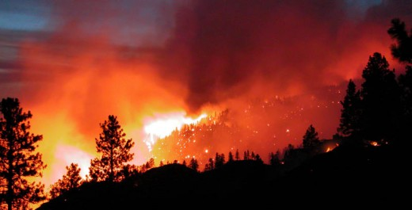
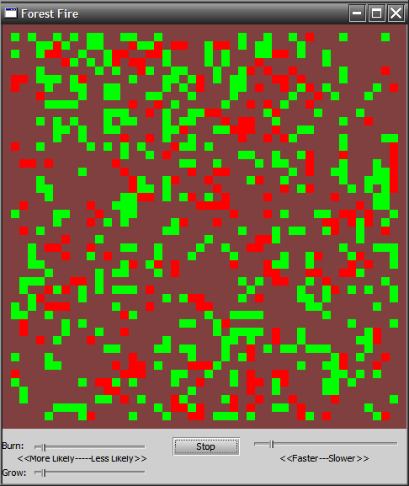
ANALYSIS OF RESEARCH PAPERS PERTAINING TO CELLULAR AUTOMATA FOREST FIRES SPREAD MODELLING USING CELLULAR AUTOMATA APPROACH
OSHO AGYEYA
15BCE1326
VIT UNIVERSITY CHENNAI CAMPUS

Slide 2
ABSTRACT
Analysis of research paper will demonstrate how forest fire spread can be predicted using cellular automata. It plays an essential role in designing quick risk management techniques and implementing effective suppression policies. As a preferable modelling approach, 2 dimensional cellular automaton (CA) has been used to understand the complex mechanisms of fire spreading.

Slide 3
PROBLEM DEFINITION
A wildfire (wild land fire, forest fire, vegetation fire, grass fire, peat fire, bushfire, hill fire) is an uncontrolled fire often occurring in wild land areas which consume houses or agricultural resources. It is a combustion reaction where the necessary ingredients for its occurrence are:
Vegetation, which provides the combustible source for the reaction
Oxygen in the air, which actuates as an oxidizing agent
Heat source responsible for the initiation
Self-sustainability of the reaction
Forest fires spread rapidly due to acceleration of combustion by winds.They cause humungous irreplaceable damage to life and property at scale. The project focuses at studying various fire spreading models using 2-D cellular automata approach to find out which areas are affected first and the manner in which forest fire spread from source to engulfing areas.

Slide 4
ISSUE MOTIVATED
CAUSES:
Unattended campfires can put things out of control and can cause wildfires.
Car crashes have been known to start fires quickly and that is why it is common to see fire-fighters rush to the scene in anticipation of a fire.
Cigarette bud on the ground trigger a big disaster.
Fireworks if not handled properly that may end up as flames in unwanted territory.
Arson is the act of setting fire to property, vehicles or any other thing with the intention to cause damage, accounts for 30% of all wildfire cases.
Lightening can cause wildfires, especially the type of lightning called “hot lightning”, which can last for a relatively long time.
Hot burning lava, from volcanic eruptions, also causes wildfires.
IMPACT OF FOREST FIRES:
When a wildfire hits this soil ,it becomes too hot and all of its nutrients are destroyed.
Extinction of certain animal species is also possible.
Trees and plants are gone as well.
Too much water poured in the soil to extinguish forest fires can cause erosion.
Large amounts of smoke causes air pollution.
Unfortunately, some human lives are also lost in wildfires.
Incomes and jobs are lost for workers in the agricultural field whose field crops and animals were destroyed by the wildfire.
Insurance premiums soar sky high after a wildfire because now everyone is looking to obtain some kind of insurance to prevent such devastating losses.
All these reasons motivated researchers to analyse forest fires in order to predict how they are spreading so that their damaging effects can be minimised. Also, the areas of a forest that are more susceptible to catching fires can then be made a priority during fire extinguishing process. In absence of proper research and analysis, this disaster poses a great threat to humanity.

Slide 5
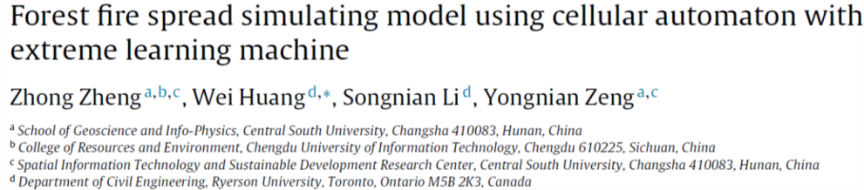
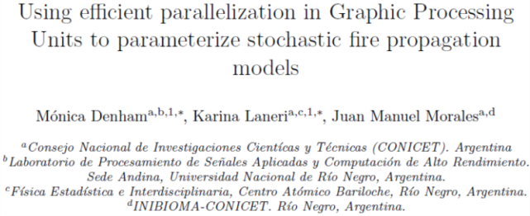
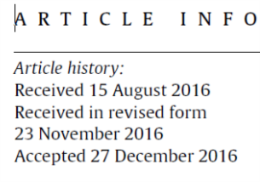
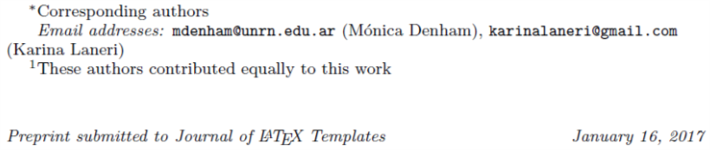
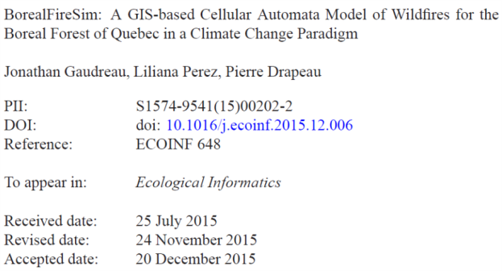
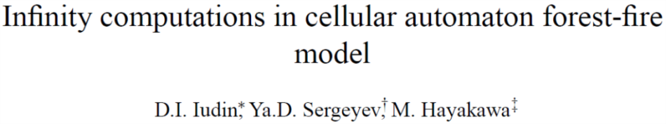
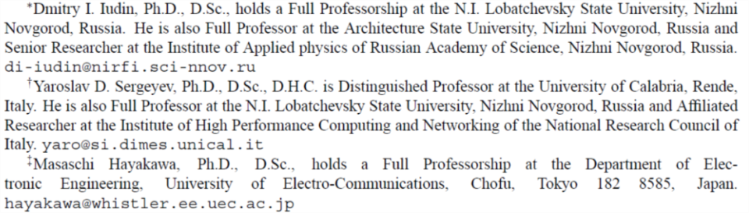
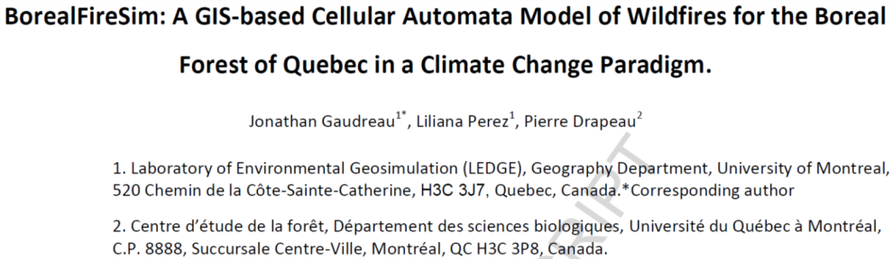
LITERATURE SURVEY

Slide 6
LIST OF MODULES
Study of the given research papers in the stated order.
Arriving at necessary mathematical inferences depicting the fire spread flow model.
Formulating results associated with each paper.
Simulation of forest fire spreading via necessary tools.

Slide 7
CONCLUSION
It is important for the academic community to come up with efficient mathematical models to simulate various natural and man made disasters to mitigate their adverse effects on humanity. The analysis shall provide base for modeling forest fire spreading so that it can be prevented from percolating further into critical areas.

Slide 8
REFERENCES
https://www.researchgate.net/profile/Zhong_Zheng15/publication/312622428_Forest_fire_spread_simulating_model_using_cellular_automaton_with_extreme_learning_machine/links/5886df42aca272b7b44cd8e3/Forest-fire-spread-simulating-model-using-cellular-automaton-with-extreme-learning-machine.pdf
https://arxiv.org/pdf/1701.03549
https://www.researchgate.net/profile/Liliana_Perez8/publication/289493955_BorealFireSim_A_GIS-based_Cellular_Automata_Model_of_Wildfires_for_the_Boreal_Forest_of_Quebec_in_a_Climate_Change_Paradigm/links/5699129d08aeeea9859456d1.pdf
http://wwwinfo.dimes.unical.it/~yaro/Forest%20Paper.PDF

